Slide 1



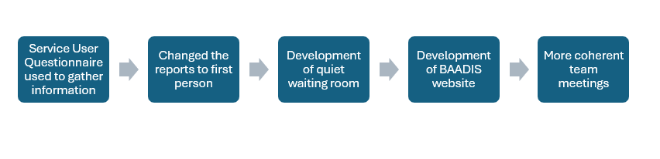
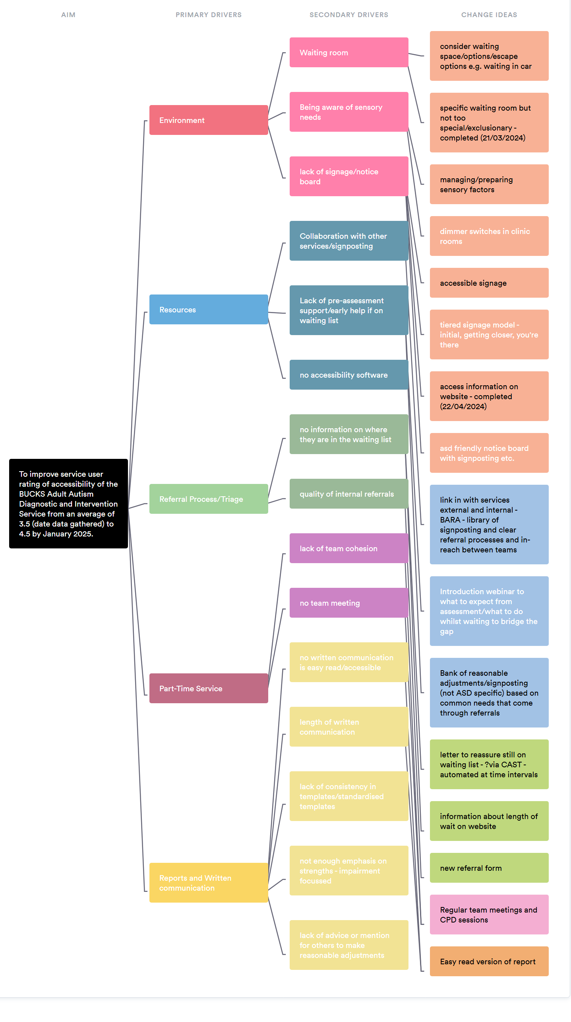
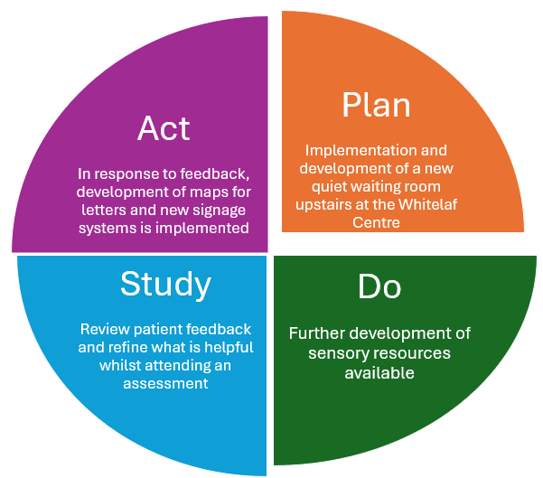
BUCKS Adult Autism Service Accessibility Project
Georgia Spooner (OT), Michaela Saunders (MH Nurse), Dr. Alison Lennox (Psychiatrist) and Bethany Fuller (SALT).
Aim: To improve service user rating of accessibility of the BUCKS Adult Autism Diagnostic and Intervention Service from an average of 3.5 (date data gathered) to 4.5 by January 2025.
Why is this important to service users, carers and staff?
Across Oxford Health NHS Foundation Trust and across Buckinghamshire Community Teams, there are potential opportunities to facilitate Neurodivergent Friendly Standards. As the Autism service we would like to use Quality Improvement to identify, pilot and refine processes, which hopefully improve the accessibility of a service, with the plan to then share successful strategies.
The Environment is often a barrier for autistic adults accessing healthcare services, including waiting rooms because of the sensory challenges associated (Doherty 2022, Haydon et. al. 2021, NDTi 2020).
Alongside the environment, there are areas where Neurodivergent Friendly Standards could be improved including, paperwork and the availability and usability of information. These are some of the areas we plan to focus on and improve.
Work So Far
Test of change have been evaluated through feedback gathered at post-diagnostic groups,
and service user questionnaires.
Data
As part of the QI project, we sought feedback as to how accessibility could be improved, here are some extracts that inspired one of our key tests of change:
“Venue fine and relatively quiet. However, it might be good to create an even calmer, dimmer and more soothing environment in the room used. Maybe some soothing colour on the wall, some sensory objects and furnishing.”
Driver Diagram
“It just felt like the reception desk is set in a bit of a ‘bottleneck’, which is difficult if you have a strong need for personal space. It would be good if there was more space in that area.”
Current PDSA
Patient Feedback methods and utilisation
Contact slips and flyers are sent out to patients
List of patients for co-production are documented and brought together
Patients are asked what recommendations/ resources they would have liked before their assessment to share with others on the waiting list through the website and is included in the webinar pathway video
Responses from patients are sought through report outcome measure
Patients have input into making group reports more accessible
How did we go about making the quiet waiting room, which would enabling meeting Neurodivergent standards:
Facilitated and followed up on the progress of the quiet waiting room
Inputted into carpet and wall colour options
Collaborate with Estates on the accessibility of the room
Seeking funding for fidget tools to use within the waiting room, assessments and groups through Oxford Health Charity
Learning and what next
Website
Worked with the Trust Communications Team to create and produce an external website
Produced a patient pathway webinar/video
By introducing the quiet waiting room, we have been able to reduce the sensory impact of the hospital environment for patients accessing an autism assessment. The development of the website has also helped to offer more support for people on the waiting list and understand the assessment process. To ensure this work is recognised and more transferable we will work towards the National Autism Society (NAS) accreditation for the service.
Reports and Letters standardisations and improvements
Reports and letters have a clear structure and formatting
Patients have input into making reports and letters more accessible and the structuring
There are different versions of these e.g. easy read
Reports are strength based and focus on their autism diagnosis
RAS/Kingswood reports are used for guidance
ADOS and ADI scoring is understood by patients
Contact Information: externalbucksadultasd@oxfordhealth.nhs.uk
The team involvement
CPD sessions are consistent and accessible for the whole team and wider services
Team meetings have agendas sent out to them from admin
Everyone in the ASD service is aware of the QI project and have input into it. – via the QI board

