Slide 1

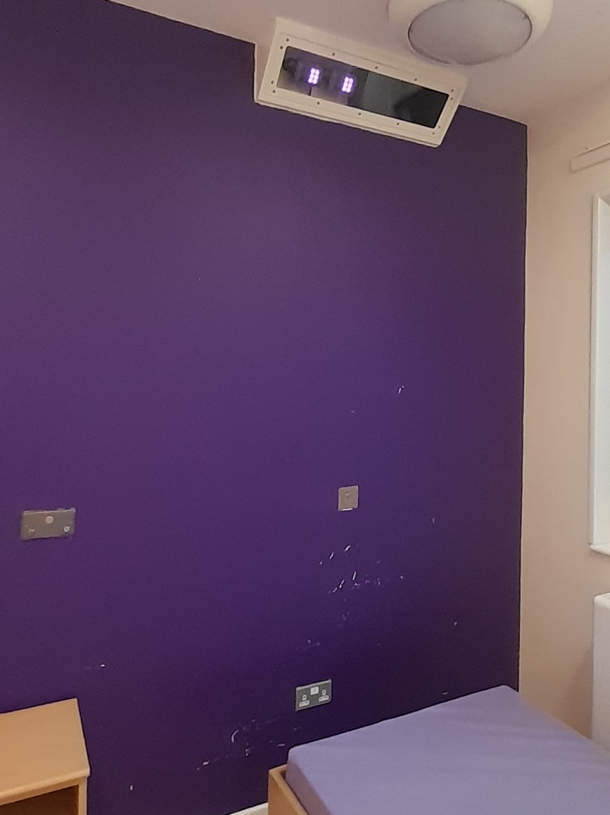
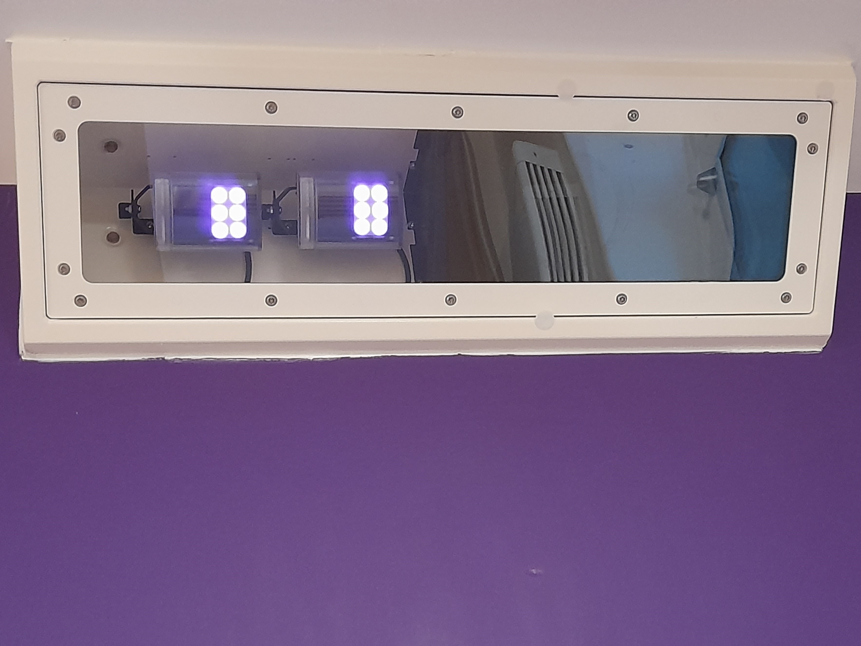


Draft subject to agreement by Patient/Service user groups.
Oxevision camera-sensors and the care in your room
What is Oxevision?
It is a monitoring device installed in your room to help keep
you safe without interrupting you.
Why Oxevision?
All patients admitted to a mental health inpatient unit must
be observed a minimum of every hour to ensure their safety,
24 hours a day, seven days a week. Staff will do observations
in person and by using the system Camera-sensors when you
are in your room.
This means, staff can either go to your bedroom and make
sure, that you are safe, or staff can check your health,
wellbeing and safety using the system camera-sensors
without going into your bedroom. The system
camera-sensors also provides readings of your pulse and
breathing rate without staff having to disturb you.
Your Choice?
The system camera-sensors is an important part of the care
that you will receive on the ward. You will be asked if you want the system
camera-sensors switched on or to remain off and to only be monitored in person.
You can also change your mind for the use of the system camera-sensors at anytime: this would not affect your care.
What is it used for?
The system camera-sensors enables staff to see if you are in your bedroom and your location in your bedroom, to check you are safe and to measure your breathing rate and pulse without the need to enter your room and disturb you at night when you are asleep.
It notifies staff when you may need help or assistance, specifically, if you have been in the bathroom a long time, if someone else has entered your room while you are there, or when you are stood or sitting close to the main door and have been there a long time, or if you have left your room at night so that they can come to check on you.

Slide 2

How will it help me?
Staff will be able to check that you are safe in your bedroom as well as measuring your breathing rate and pulse without having to disturb you at night.
How does it work?
The system uses an infrared camera and two infra-red illuminators to record activity in the room. When switched on the system camera-sensors runs continuously but Staff are only able to use the camera when they need to view into the room to check you are safe or to measure your breathing rate and pulse. You may notice a red "glow" from the sensor housing unit. This is from the Infra-red illuminator and is not a sign that Staff are using the camera to view into the room.
Hours of Use
The hours that the system camera-sensors maybe used by staff are displayed on Posters in the Ward. At all other times, the system camera-sensors is turned off and not used by staff.
Am I being recorded?
Clear video data is stored on site for 24 hours before being deleted and later recorded over. These images are only viewed by authorised persons to investigate serious safety concerns when there is no alternative. This could be an investigation into a physical safety matter or a medical safety matter concerning the Oxevision software. You will be notified should this happen.
All other retained system camera-sensors data is anonymous (blurred) and not patient identifiable. Patient privacy and dignity are taken very seriously and there are strict data privacy processes in place. For more information about how the Trust uses personal information and the purposes personal information may be used for please go to the Trust website:
https://www.oxfordhealth.nhs.uk/privacy/
Can staff see me in my room?
The system is not a constant video feed like CCTV. Staff can only see a 15-second video when they need to measure your breathing rate and pulse or respond to an alert to check you are safe. Staff must come to check on you in person if they cannot obtain the information in this time. Only video images are captured. There is no sound recorded. At all other times staff only see the view below on the monitor until they need to measure your breathing rate and pulse or respond to an alert to check you are safe.

Slide 3
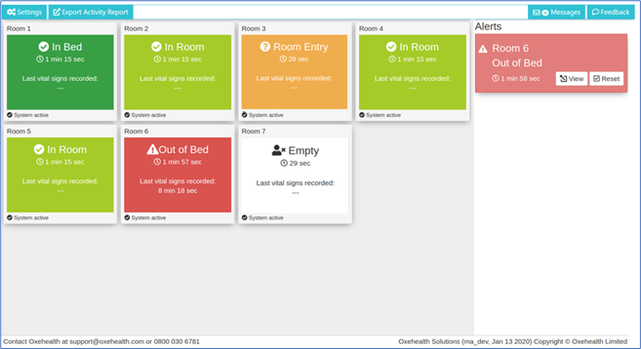
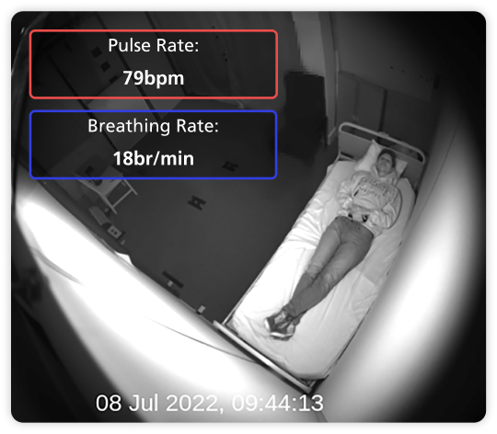
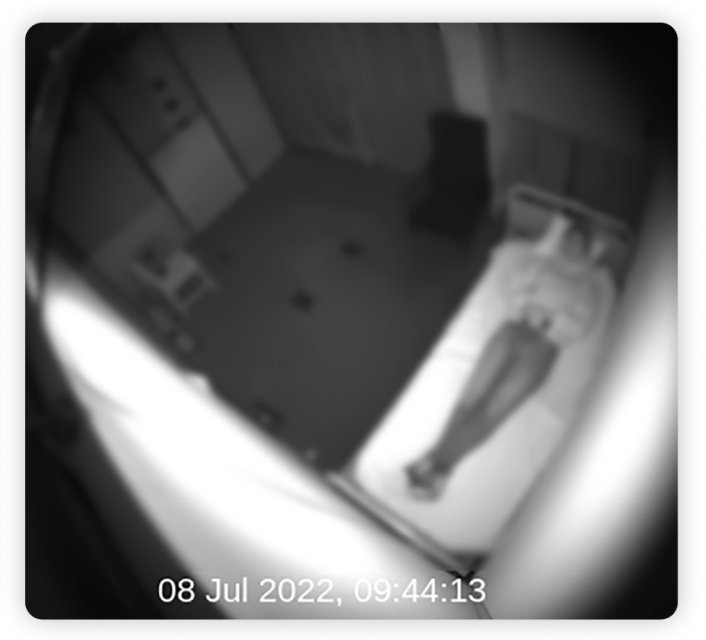
Oxevision Monitor view
Taking observations or responding to alerts
When taking an observation, a clear image is shown so pulse and breathing rate can be taken. When responding to an alert the image is blurred to preserve privacy and dignity. In both cases the video feed is terminated after 15 seconds. A management direction restricts staff from
viewing each occurrence more
than two times in succession
Example of a 15 seconds (clear) view for spot check pulse and breathing rate observations
Example of a 15 seconds (blurred) view for responding to an alert triggered about your room
If you would like to learn more or have further questions, please ask a member of staff who will be happy to explain

