Slide 1

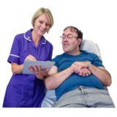
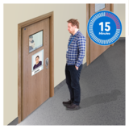
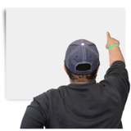
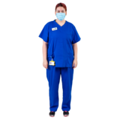
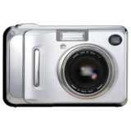
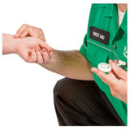
Oxevision camera-sensors and the care in your room
All mental health wards must check patients well being a minimum of every hour to ensure their safety 24 hours per day.
You can choose if the system camera-sensors or staff check if you are well during your time in hospital
The checks will be made by staff during the night and day.
Staff would check you are breathing.
Staff would check you are well.
Staff could check your pulse.
or
The system camera-sensors can also check you are safe and well at night.
The system camera-sensors checks your breathing and your pulse.
This means staff will not need to come to your room at night and wake you as often.

Slide 2


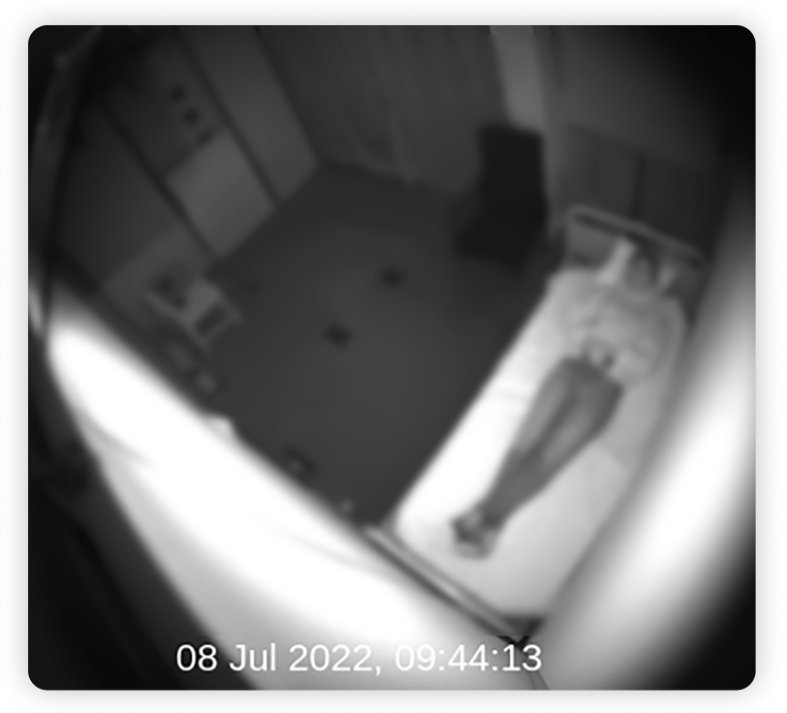
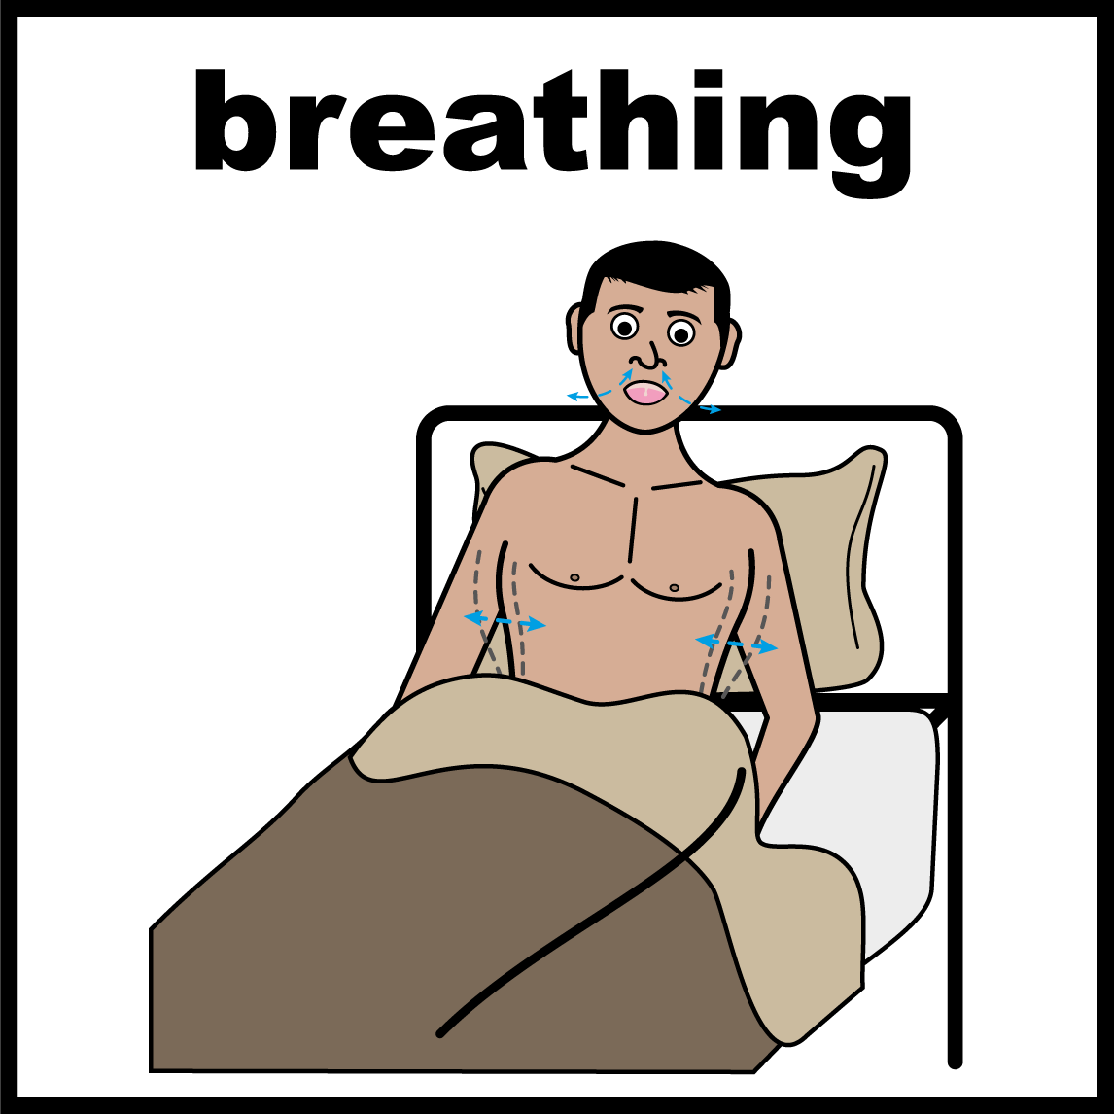
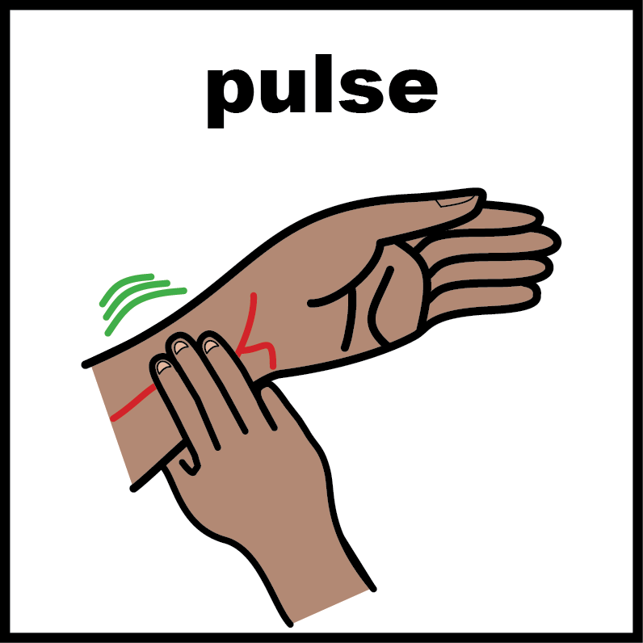

This information will help you to decide if you :
Would like the system camera–sensors to check you when you are in your room at night?
Or
If you would like staff to check your breathing and pulse?
You can decide what will work best for you.
How the camera–sensors are used
To check if you are in your room.
To check your breathing and pulse at night.
To alert staff if you may need help.
To let staff know if anyone else enters your room.
To let staff know if you leave your room.

Slide 3

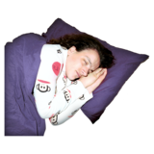

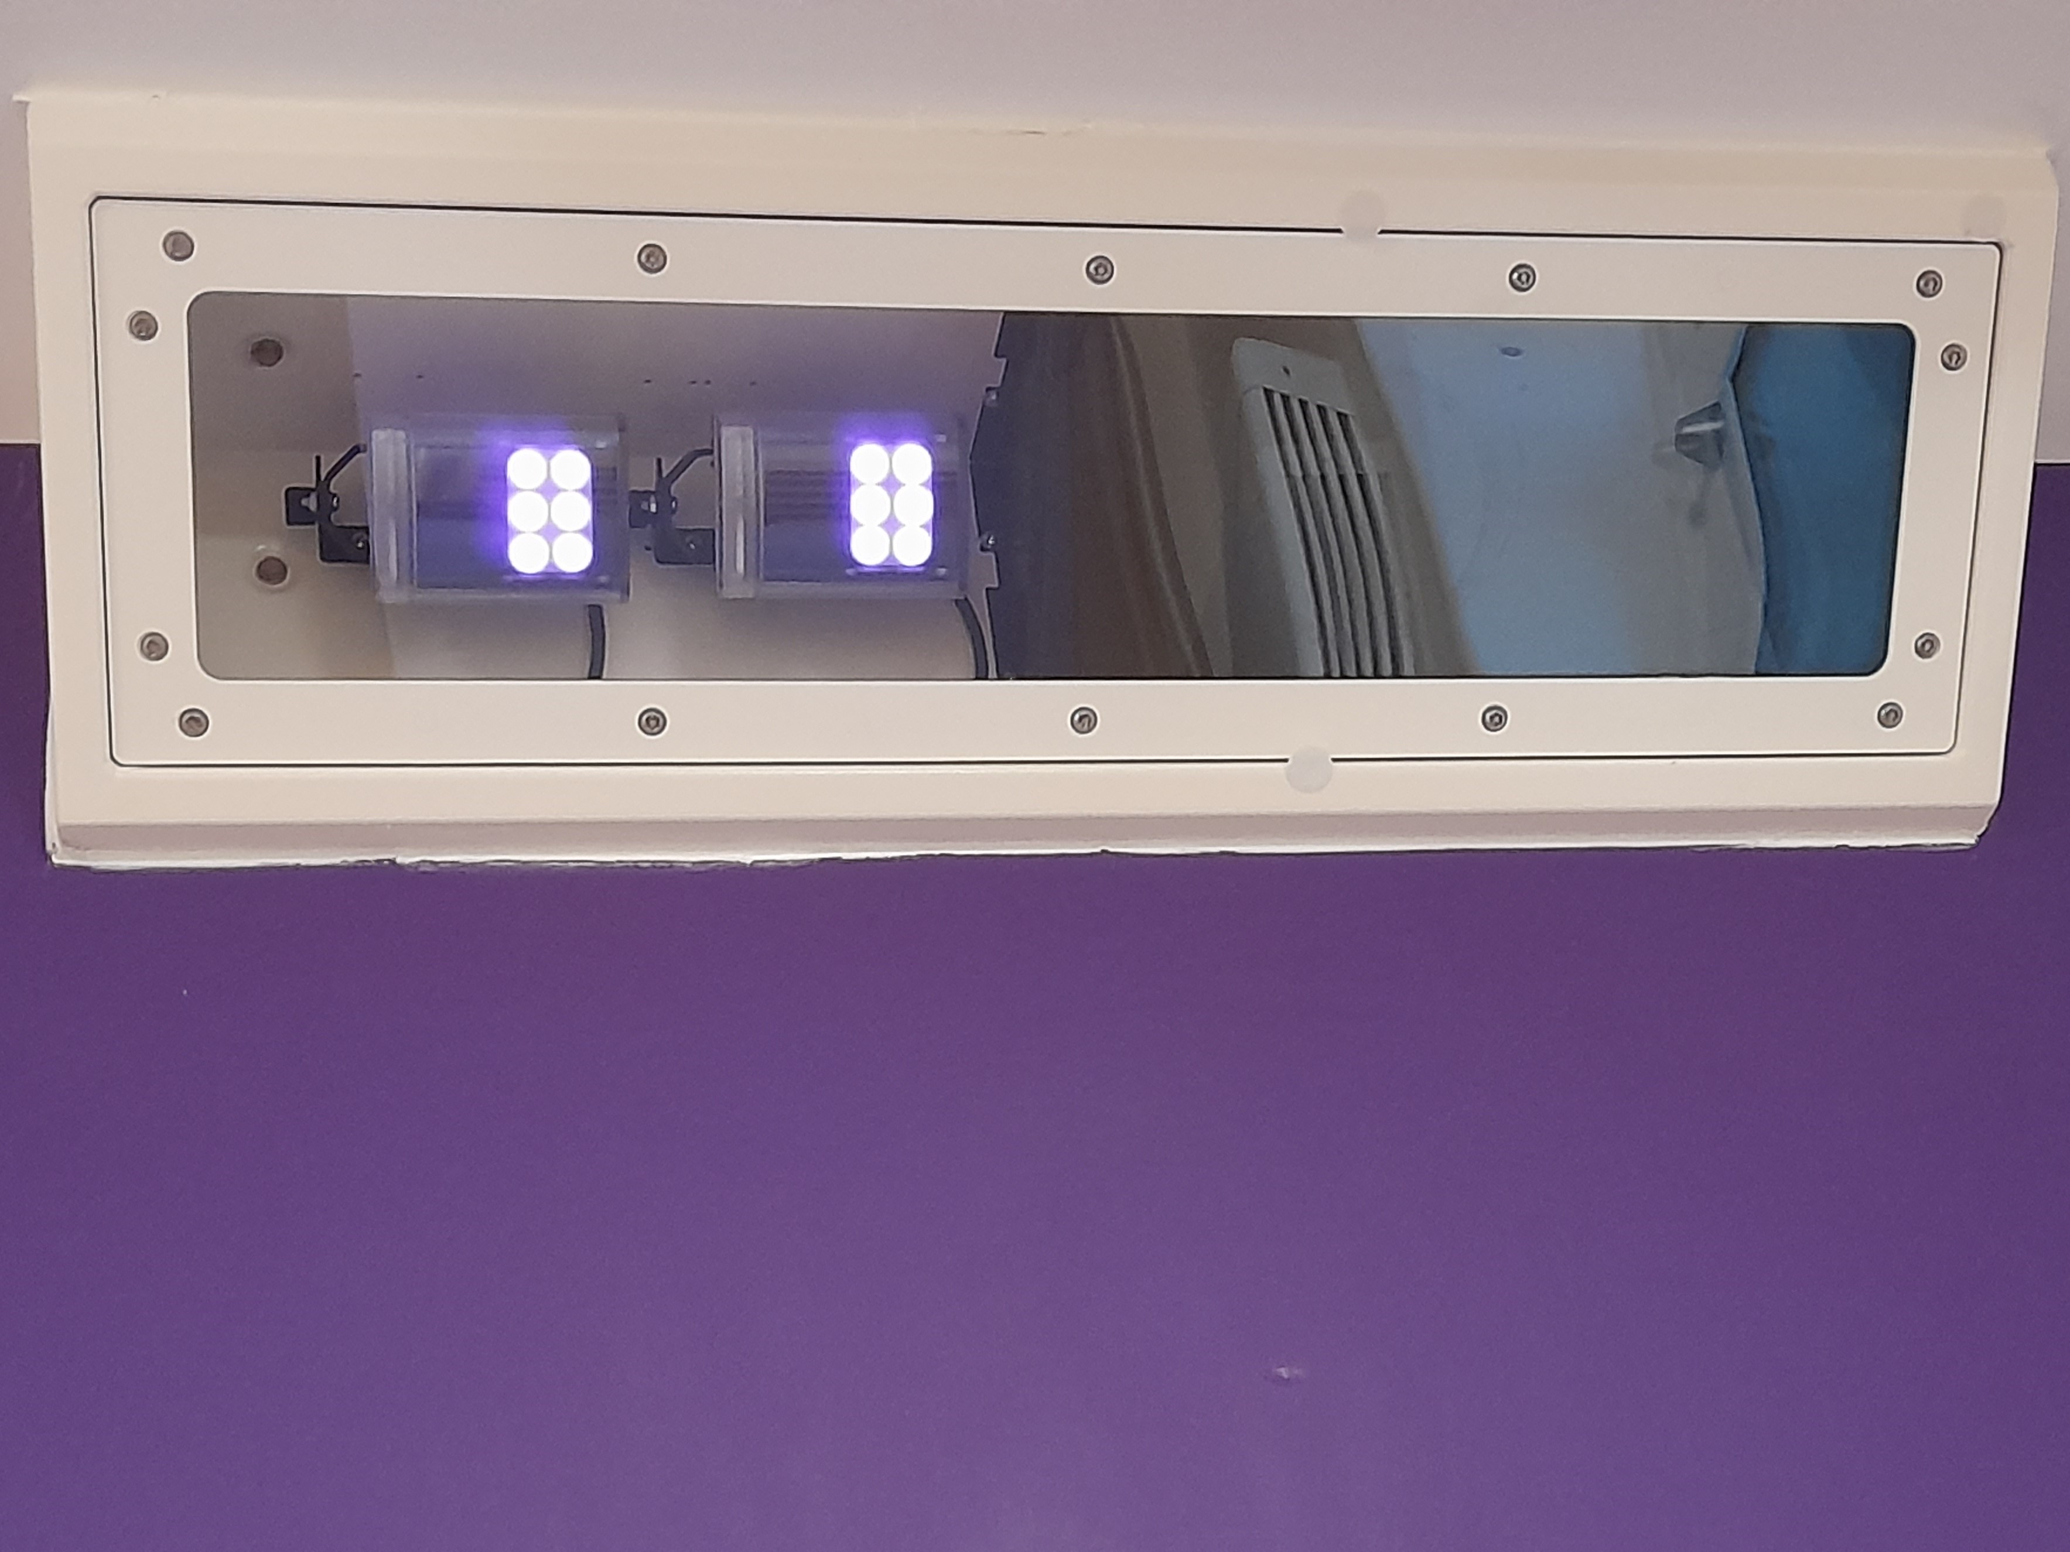
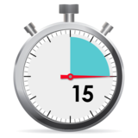
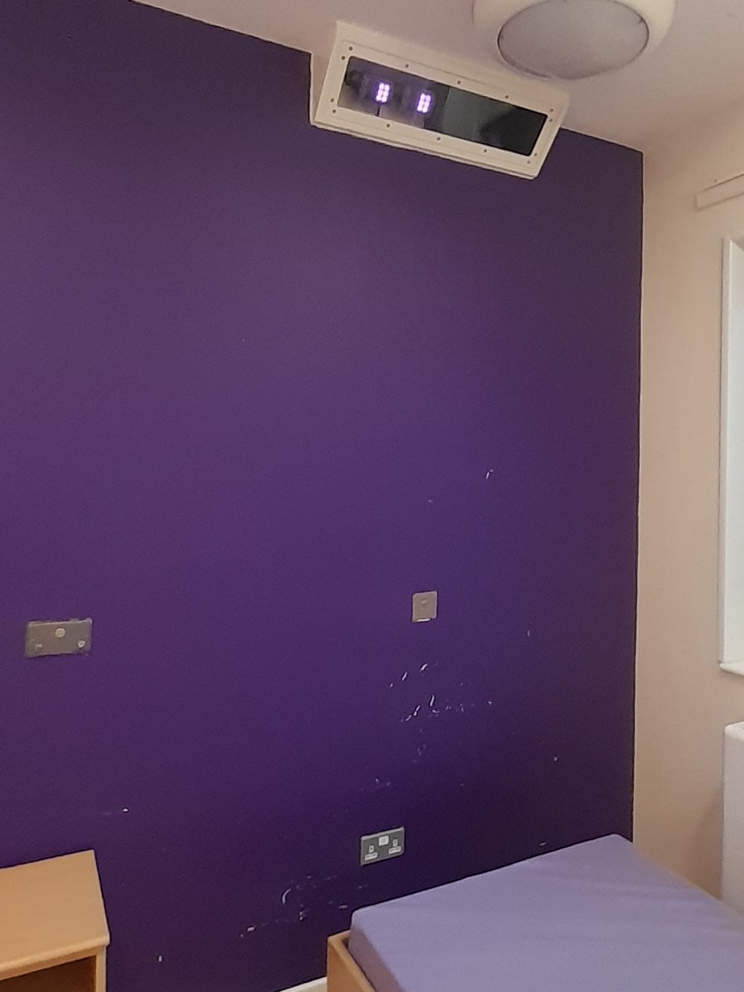

What some people like about the system camera-sensors:
Some people feel that they sleep better with the system camera-sensors.
It alerts staff if you may need help :
  If you have been in the bathroom a long time.
  If someone enters your room
Staff do not need to touch people to check they are safe and well.
The camera–sensors are on all night, but staff can only use the camera when they need to check on you or take your pulse and breathing rate at night. During the day, the camera-sensors are turned off and not used by staff.
The camera just works for 15 seconds when staff need to check you are well or to take your pulse and breathing rate.
What some people don’t like.
Some people don’t like having a camera in their room.

Slide 4
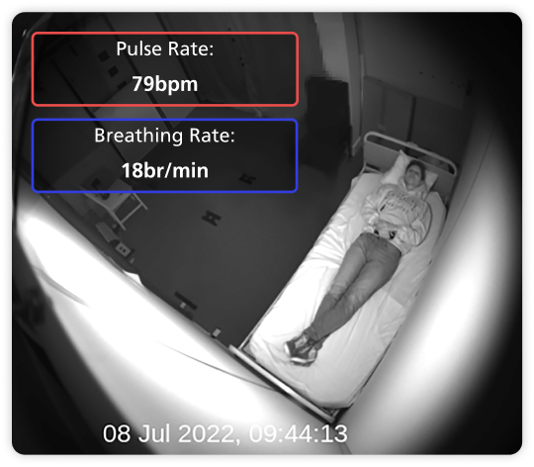



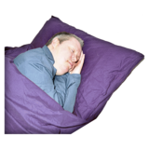
Some people like staff to check their health.
This clear picture shows you what staff can see when the camera is used for observations.
The camera is used for 15 seconds to check your
Breathing
Pulse
This blurred picture shows you what staff can see if there is an alert from your room.
The video taken is kept for 24 hours or 1 whole day.
The video will only be looked at if there if something happens on the ward that needs investigating.

Slide 5
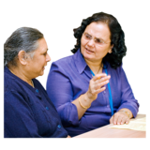


If you have any questions, please ask a member of staff.
If you would like to try the system you can.
It is your choice.
You can choose for the camera-sensors to check you are well at night.
Or
Staff to check you are well
We want you to choose what will work best for you.

