Slide 1
How Hydrated are you?
Water makes up two thirds of our body. It is vital we drink enough fluid to maintain a healthy balance. Many people get dehydrated by not drinking enough fluid or by losing fluids and not replacing them
You’re well hydrated!
Drink a glass of water
You need 1-2 glasses of water
You need 2-4 glasses of water
You need more than 4 glasses of water or medical attention
Pale Yellow
Straw
Golden Yellow
Golden Orange
Pale Amber
Amber
Rich Golden Amber
Copper Brown
Orange Brown
Mild Brown
Ruby Brown

Slide 2
How Hydrated are your Patients?
Signs of dehydration are visible in your urine. Dark and strong smelling urine is a clear sign that you need to drink more fluids
If the colour of your patient urine matches 1, 2 or 3, it can be used as an indication that they are hydrated
Healthy urine is 1-2-3!
If the colour of your patient urine matches 4, 5 or 6, they need to drink more. Update their care plan to ensure regular drinks are offered and drunk. Allocate a member of staff to assist patient to drink for the next 24/48 hours.
4-8 you must hydrate!
If the colour of your patient’s urines matches 7 or 8 – it may be an indication that your patient is dehydrated
Urgent fluids
Update fluid chart
Observe for other signs of deterioration
Contact doctors if necessary
Note: some foods, vitamins and medication can change the colour of urine. Also, be aware if your patient is on a fluid restriction for heart or renal failure.
Good Hydration! - Patient Safety Oxford

Slide 3
Why does the older person become dehydrated?
❖The elderly have a reduced thirst so may not know when they are thirsty
❖Unable to communicate (cannot say when they are thirsty)
❖Pre-existing medical conditions e.g. diabetes, stroke.
❖Dementia
❖Cognitive impairment
❖Medications e.g. diuretics
❖Illness
❖Fear of incontinence due to drinking
❖Mobility and dexterity issues
❖Excessive fluid losses
Good Hydration! - Patient Safety Oxford

Slide 4
What are the signs and symptoms of dehydration?
pain when urinating (UTIs)
dry mouth, lips or eyes
thirst
dizziness
headaches
tiredness
lack of concentration
If dehydration is left untreated, it can become severe. Severe dehydration is a medical emergency and requires immediate medical attention.
Symptoms of severe dehydration include:
feeling unusually tired (lethargic) or confused
not passing urine for eight hours
a weak pulse
a rapid pulse
fits (seizures)
a low level of consciousness
If severe dehydration is not treated immediately it can lead to complications such as secondary UTI symptoms (e.g E. coli bloodstream infections similar to sepsis) and falls due to dizziness. Severe dehydration can be life threatening, particularly for older people.
www.nhsinform.scot/campaigns/hydration

Slide 5
Some of the signs that can indicate a patient may be dehydrated?
❖ Dry mouth
❖ Headache
❖ Dizziness
❖ Tiredness
❖ Confusion or not wanting to take part in activities
❖ Constipation
❖ UTI (urinary tract infections)
❖ Colour of their urine
❖ Pressure ulcers
❖Falls
❖ Kidney stones
❖ Low blood pressure
❖ Medication toxicity
Good Hydration! - Patient Safety Oxford

Slide 6
Good hydration prevents
urinary tract infections (UTIs)
headaches
constipation
dizziness that can lead to falls
confusion
kidney stones
pressure ulcers/skin conditions
poor health
www.nhsinform.scot/campaigns/hydration

Slide 7
Who is at risk of dehydration?
Anyone can become dehydrated, but some groups are particularly at risk. These include:
babies and infants – they have a low body weight and are sensitive to even small amounts of fluid loss
older people – they may be less aware that they are becoming dehydrated and need to keep drinking fluids
people with a long-term health condition – such as diabetes or alcoholism
athletes – they can lose a large amount of body fluid through sweat when exercising for long periods
Good hydration is important for all age groups and is something for everyone to consider.
www.nhsinform.scot/campaigns/hydration

Slide 8
How can you stay hydrated?
You should drink plenty of fluids such as water, diluted squash and fruit juice, tea and coffee (decaf) to stay hydrated. The key is to drink regularly throughout the day (at least 6-8 mugs).
If you're active, or if the weather is particularly hot, there's a greater risk that you will become dehydrated. To stay hydrated, you should increase your fluid intake.
If you, your child or someone you are caring for is ill, particularly with a fever, vomiting or diarrhoea, there's a high risk of becoming dehydrated, so it's important to start replacing fluid as soon as possible.
If you are finding it difficult to keep water down because you're vomiting, try drinking small amounts at a time to stay hydrated.
If you work in a care setting, plan visits around meal times to get a sense of what the person is drinking. Ensure the person has access to water or fluids and advise them of the recommended daily intake.
Remember you can always use the urine colour chart to monitor your hydration levels.
www.nhsinform.scot/campaigns/hydration

Slide 9
Urinary Tract Infections
How do I know if someone has a UTI?
Any two new symptoms of following:
New onset or worsening of pre-existing confusion/agitation/drowsy
Shaking/chills/high temperature >38.0 or <36.0
Dysuria – difficulty or pain passing urine
Urgency – needing to go to the toilet quickly
Frequency – needing to urinate more often than normal
Urinary incontinency – unintentional loss of urine
Pain in the side of the body or above the groin area
Blood in the urine
Good Hydration! - Patient Safety Oxford

Slide 10
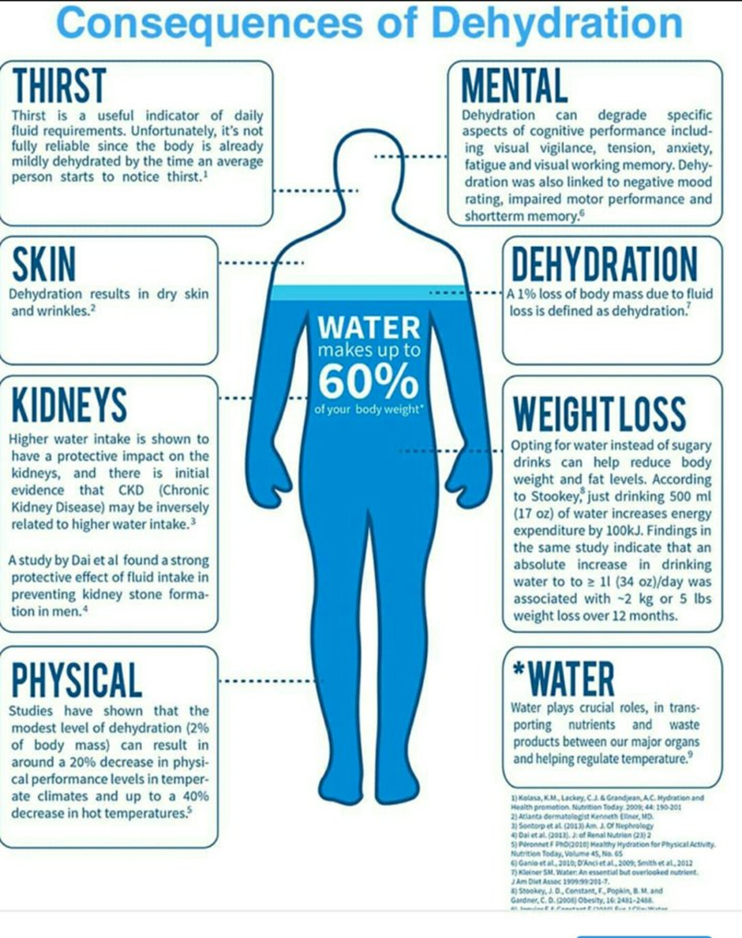
Consequences of Dehydration

Slide 11
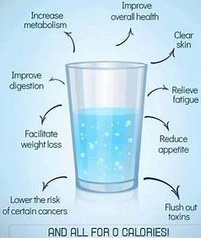
8 CUPS OF WATER A DAY WILL

