Slide 1





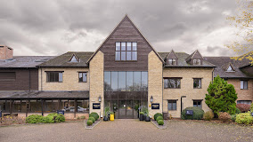
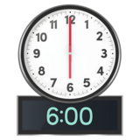

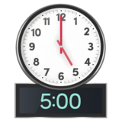
Annual Members Meeting and Annual General Meeting
Agenda
The Voco - Oxford Spires hotel, Abingdon Road, Oxford, OX1 4PS
You are welcome to arrive from
There will be some information stands to look at.
The meeting will be 6pm-8pm

Slide 2

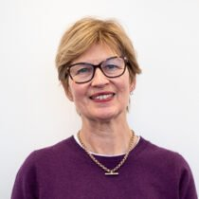
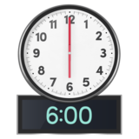

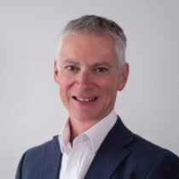



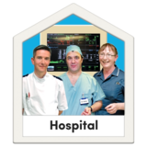



 | 1. Introduction and welcome | Andrea Young, Chair
 | 2. Chief Executive’s summary and look ahead | Dr Michael Holland, Chief Executive
 | 3. Focus on Trust teams Urgent mental health care in Oxfordshire | Team leads
 | Delivering care at home and avoiding hospital admissions | Team leads

Slide 3





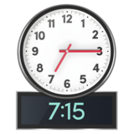
 | Questions about the presentations
 | 4. Annual Accounts and Annual Report for the Trust | Chief Finance Officer, Heather Smith
 | 5. Lead governor update | Lead Governor, Vicki Power

Slide 4

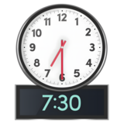

 | 6. Time for questions | Chair, Andrea Young
 | 7. End of meeting | Chair, Andrea Young

