Slide 1



General Meeting of Council of Governors
Easy Read Agenda

Slide 2










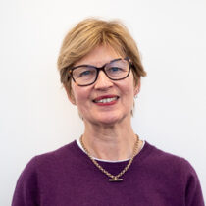
 | Agenda item | Purpose | Who Speaking
 | Thursday 17th September, 2026 5.30pm -7.30pm
 | Meeting held at the POWIC Centre, Warneford Hospital, Oxford
 | 1. Introductions and welcome |  | Chair – Andrea Young
5:30

Slide 3







 | 2. Apologies from people not able to be at the meeting Check that there are enough people at the meeting to make decisions. |  | Chair – Andrea Young
 | 3. Declaration of interests |  | Chair – Andrea Young
 | 4.Minutes of the last meeting on the 11th June 2026 |  | Chair – Andrea Young

Slide 4





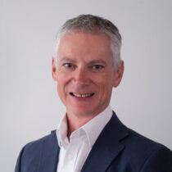
 | 5. Presentation on the experience of Learning Disability Experts by Experience in Trust recruitment |  | Rachel Miller
 | 6. Chair’s report |  | Chair – Andrea Young
 | 7. Chief Executive’s report |  | Chief Executive – Dr Michael Holland
5:35

Slide 5

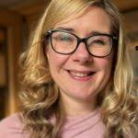
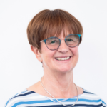


 | 8. Lead Governor Report |  | Lead Governor – Vicki Power
 | 9. Non-Executive Director update on recent work – Chair of the Quality Committee |  | Helen Mackenzie
 | 10. External Audit Report |  | External Auditors
6:30

Slide 6






 | 11. Trust Annual Report & Accounts 2025/26 |  | Chief Finance Officer & Executive Director of Corporate Affairs
 | 12. Council appointments |  | Chair – Andrea Young
 | 13. Questions from the public and Close of meeting |  | Chair – Andrea Young
 | Private meeting - Chair and Governors only |  | Chair – Andrea Young
6:45
Private

