Slide 1

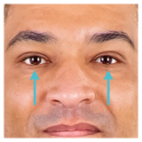
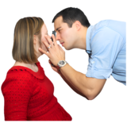
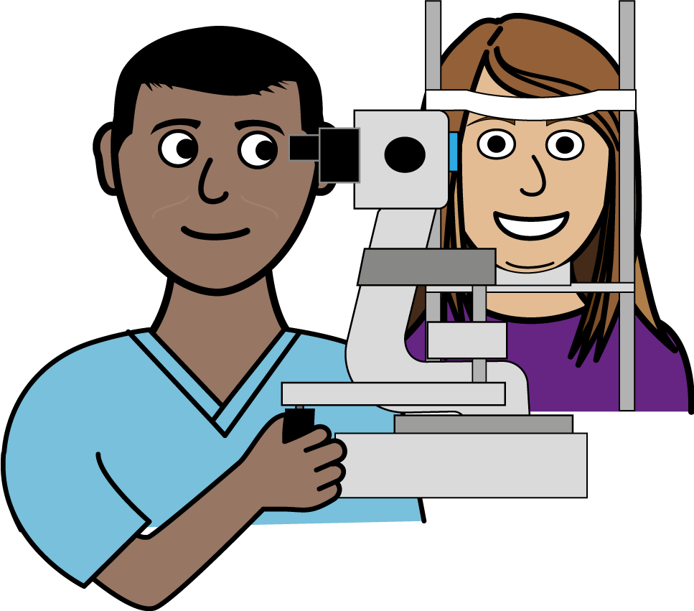
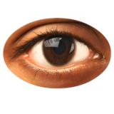
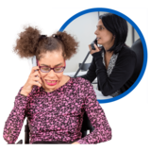
Diabetic Eye Screening
You should have your eyes screened every 1-2 years if you are older than 12 and have diabetes.
This is a free NHS service.
Eye screening checks for changes at the back of your eyes. This is important because if changes are not treated, they can cause problems with your sight.
Eye screening is different from a regular eye test at an opticians.
You will be asked to see an eye specialist. They will put drops in your eyes before the test.
They will take photos of your eyes.
The test does not hurt, and nothing will touch your eyes.
If you have not had your eyes checked in the last 12 months you should speak to your GP.
You can also call the Oxford Eye Hospital screening program on 01865 231586.

