Slide 1


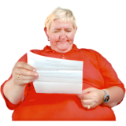

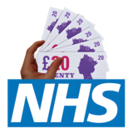

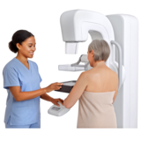
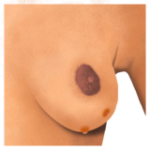
Breast Screening
If you are female or registered female with a GP and are aged 50 to 71, you will be invited for NHS breast screening .
You will get a letter in the post.
For men, transgender men and non- binary you can ask your GP for Breast Screening.
This NHS service is free.
You will be offered an X-ray of your Breasts. This X-ray is called a mammogram.
You will be offered a mammogram every 3 years.
It is good to check your breasts regularly yourself. Your GP can also help with this.
Speak to your GP if you notice any lumps or changes in your breasts,

