Slide 1


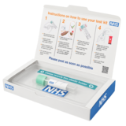

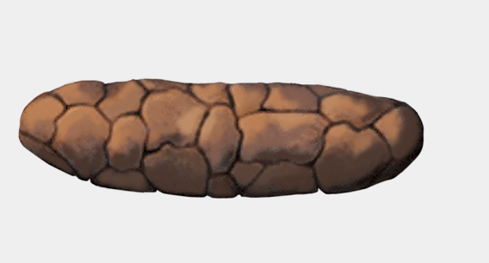
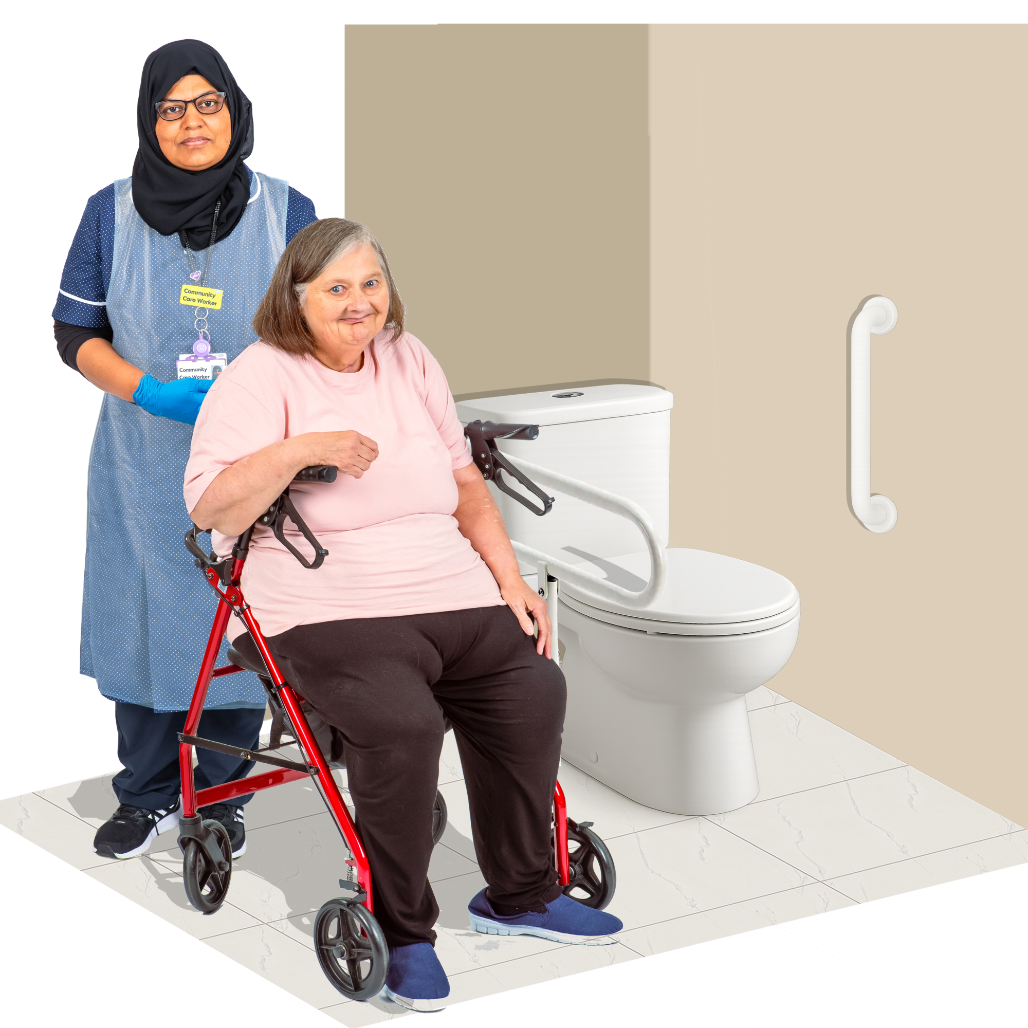
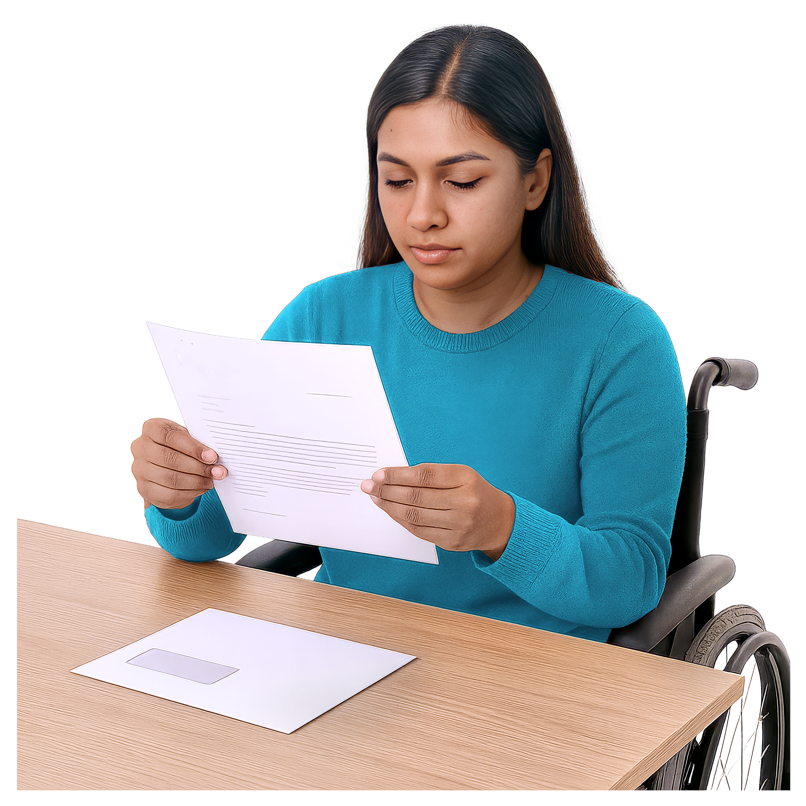

Bowel Screening
If you are between 50 and 74 years old, you can have a free bowel screening test every 2 years.
This is the free NHS Bowel Screening kit you will be sent in the post.
The kit checks for blood in your poo. Blood in your poo can be a sign of bowel cancer.
If you see blood in your poo at any time, call your GP.
The test is easy to do. You just need to do a poo. You will be given clear instructions.
You might want to ask someone you trust, like a family member, to help you with the test.
You send the test off in the post.
You get a letter with the results.
If you need help, call the Bowel Cancer Screening Helpline at 0800 707 60 60 and select option 2.

