Slide 1





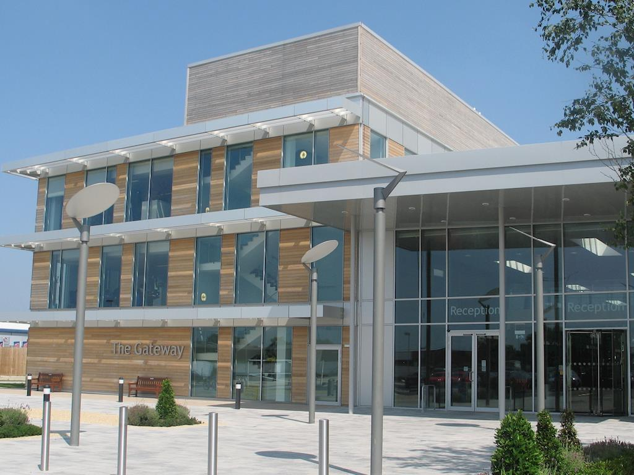



Annual Members Meeting and Annual General Meeting.
Agenda
The Gateway Conference Centre, Gatehouse Road, Aylesbury, HP19 8FF
You are welcome to arrive from
There will be some information stands to look at.
The meeting will be 6pm-8pm

Slide 2




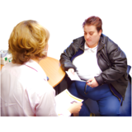






 | 1. Introduction and Welcome | David Walker, Chair
 | 2. Chief Executive’s Summary 2024-25 | Grant MacDonald, Chief Executive
 | Accessing urgent mental health services in Buckinghamshire | Head of Service, Adult Mental Health
 | Hospital admission avoidance | Head of Children’s Community Services & Head of Service (Same Day Treatment Services)

Slide 3






 | Buckinghamshire Talking Therapies | Clinical Lead Buckinghamshire Psychological Therapies
 | Questions about the presentations
 | 4. The Annual Accounts and Annual Report for the Trust | Chief Finance Officer

Slide 4
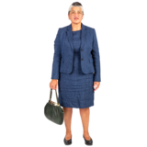






 | 5. Lead governor update | Lead Governor
 | 6. Questions
 | 7. End of meeting | Chair

