Slide 1
General Meeting of Council of Governors
Easy Read Agenda

Slide 2
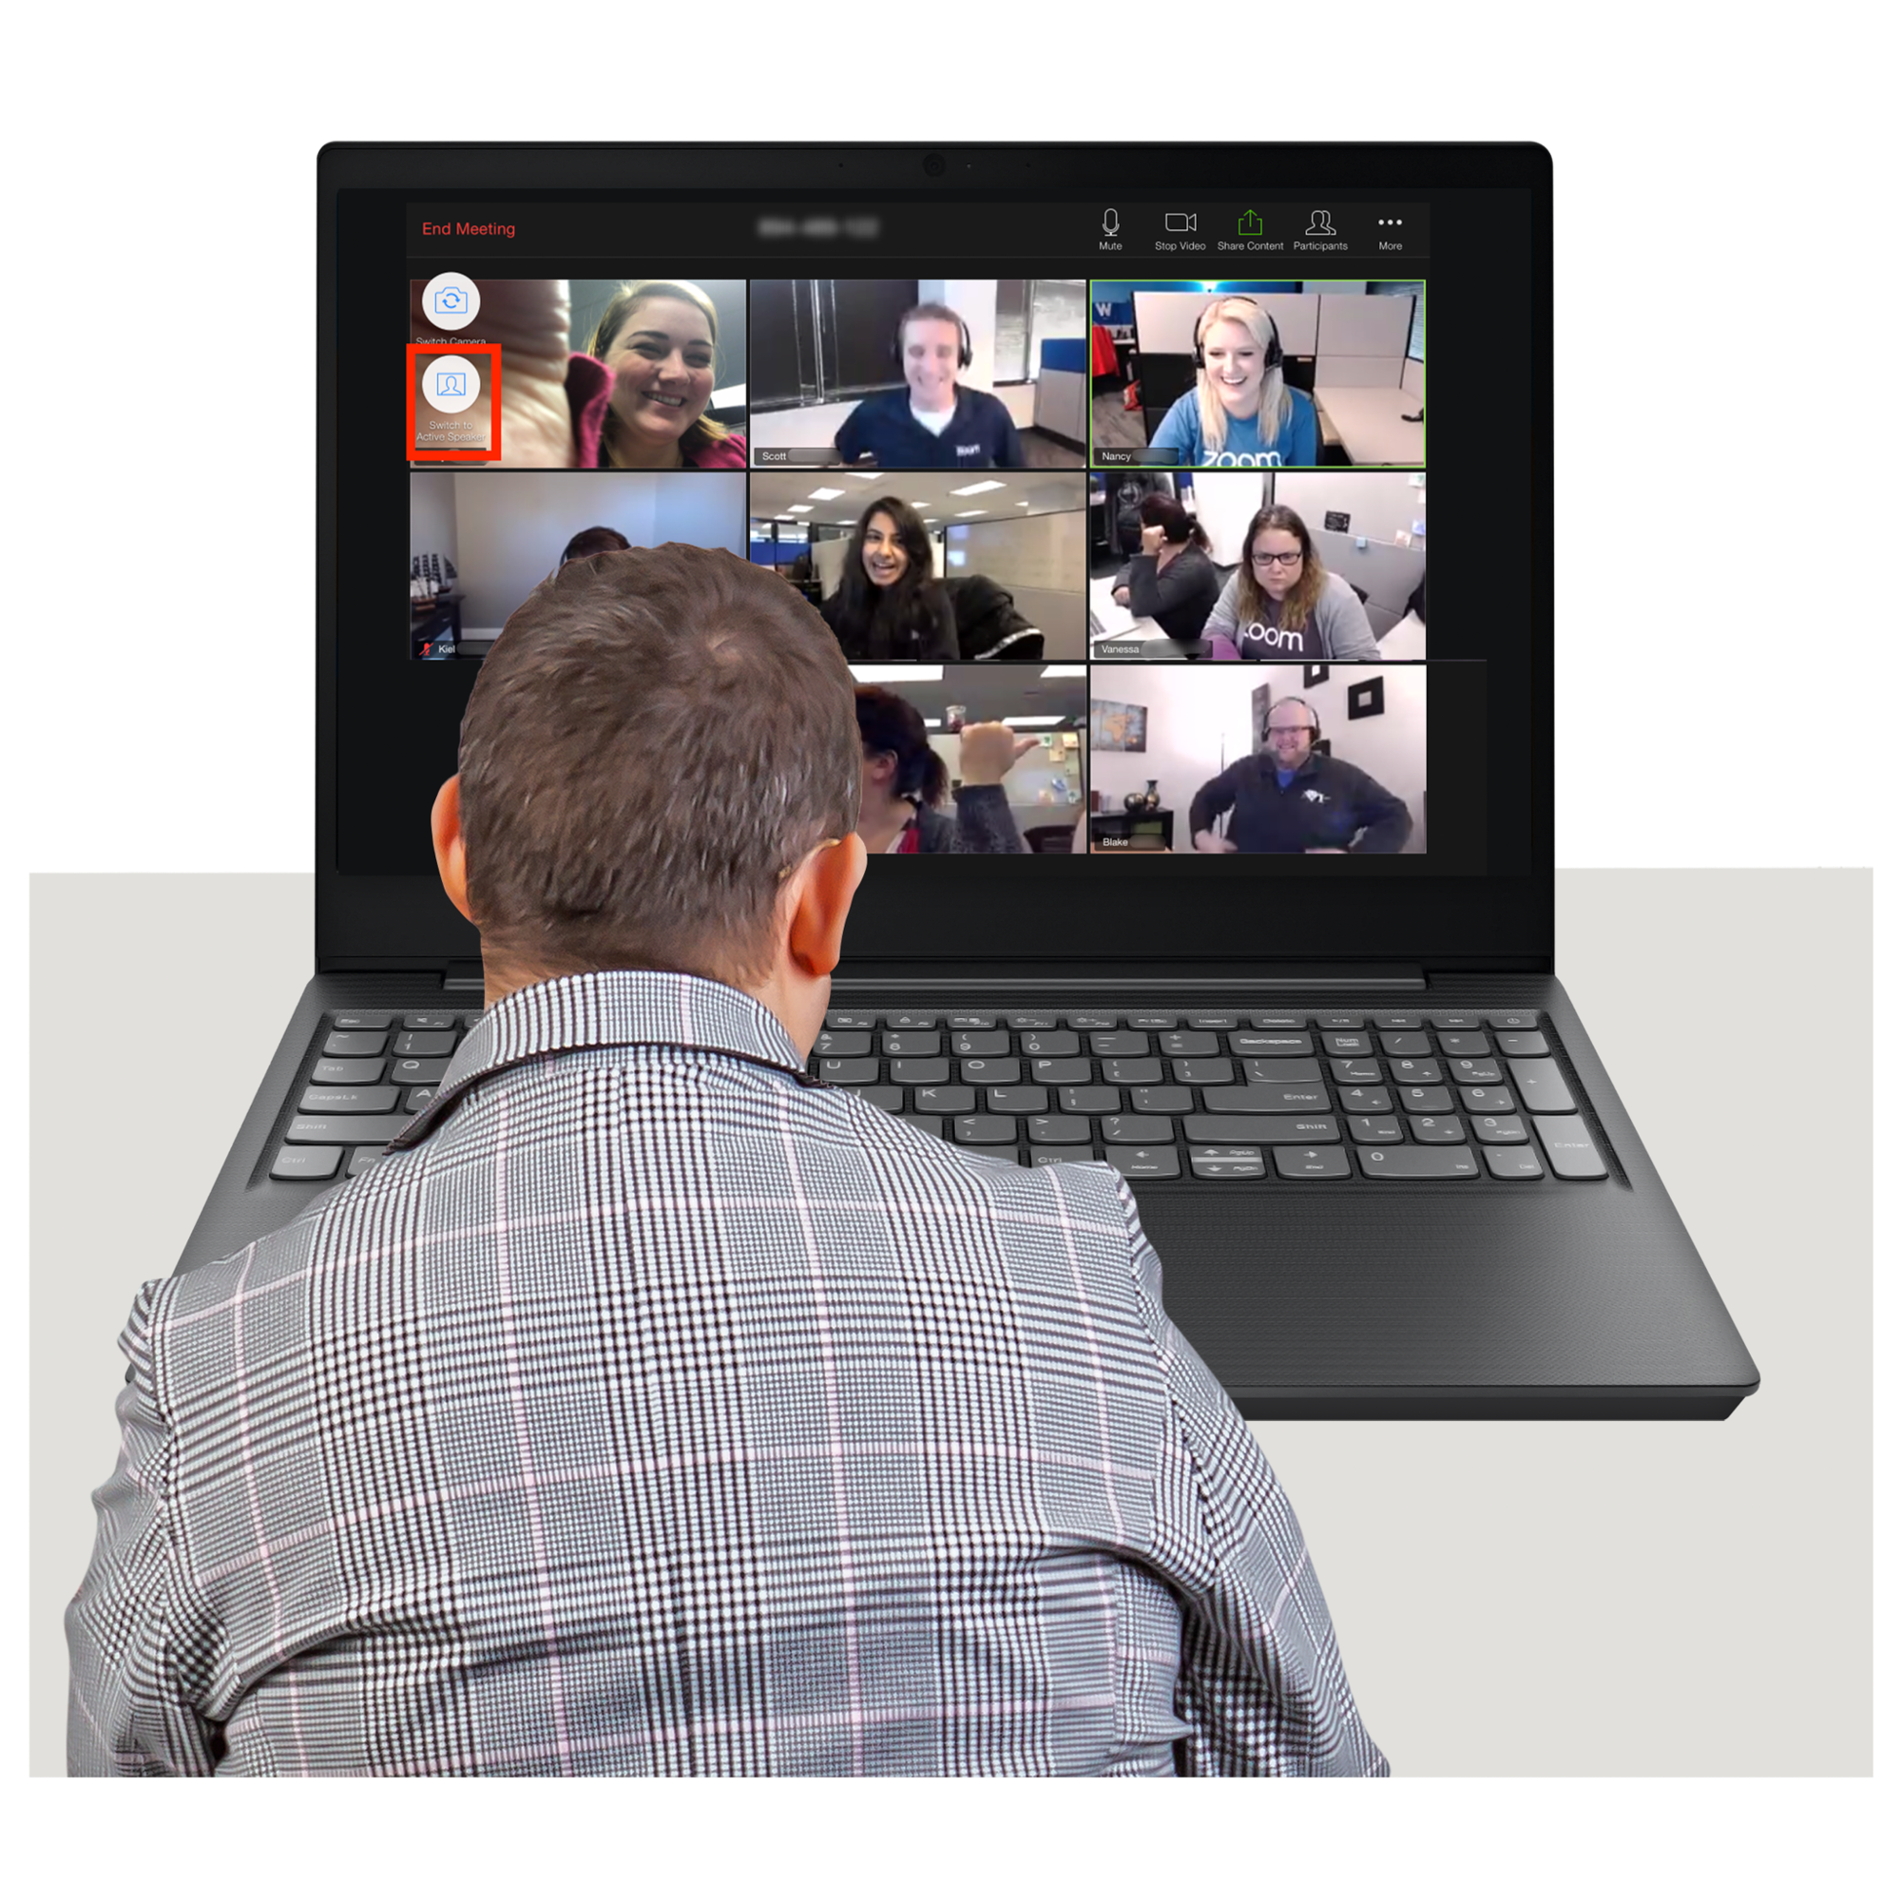
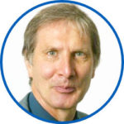
 | Agenda item | Who Speaking
 | 14th March 2024 5.30pm -7.15pm
 | Virtual meeting on Microsoft Teams
 | 1. Introductions and welcome | Chair

Slide 3
 | 2. Apologies from people not able to be at the meeting Check that there are enough people at the meeting to make decisions | Chair
 | 3. Declaration of interests | Chair
 | 4. Minutes of the last meeting on 7th December 2023 and matters arising | Chair

Slide 4
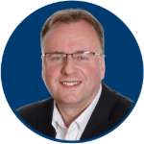
 | 5. Patient Story – Thames Valley Forensic Mental Health Service | Chief Nurse/Matt Knight
 | 6. Update Report from Chair | Chair
 | 7. Update Report from Chief Executive | Chief Executive

Slide 5
Lead Governor
 | 8. Update Report from Lead Governor
 | 9. Update from Governor Sub-group Chairs | Sub-group Chairs
 | 10. Talking Therapy Services update
Rob Bale/Jo Ryder /John Pimm

Slide 6
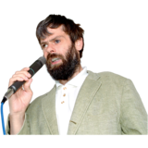
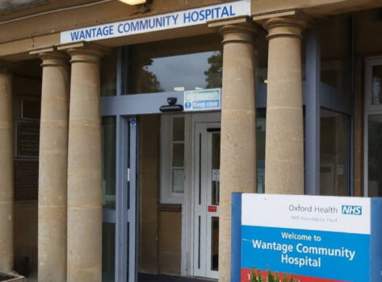
 | 11. Chris Hurst: Reflections of a Non- Executive Director | Chris Hurst
 | 12. Annual Plan 24/25 draft update | Amelie Bages/Priya Thompson
 | 13. Wantage Community Hospital future services | Sue Butt/Ben Riley

Slide 7
 | 14. Governor Election update and membership Strategy | Deputy Director of Corporate Affairs
 | 15. Fit and Proper Person Test (reminder) | Director of Corporate Affairs & Company Secretary
 | 16. Annual Appointment of Lead Governor | Director of Corporate Affairs & Company Secretary

Slide 8
 | 17. Questions from the public - Questions arising from papers in the reading room | Chair
 | 18. Close of meeting | Chair
 | Next meeting:

